Slide 1
Sets
Sets are used to store multiple items in a single variable.
A set is a collection which is both unordered and unindexed.
Duplicates Not Allowed - Sets cannot have two items with the same value. Duplicate values will be ignored
Unchangeable - Sets are unchangeable, meaning that we cannot change the items after the set has been created.
Once a set is created, you cannot change its items, but you can add new items and remove the items.
fruits={"apple","banana",'grapes','watermelon','custardapple','orange'}
print(fruits)
fruits1=set(("apple","banana",'grapes','watermelon’, 'apple'))
print(fruits1)

Slide 2
Method | Description
add() | Adds an element to the set
clear() | Removes all the elements from the set
copy() | Returns a copy of the set
difference() | Returns a set containing the difference between two or more sets
difference_update() | Removes the items in this set that are also included in another, specified set
discard() | Remove the specified item
intersection() | Returns a set, that is the intersection of two other sets
intersection_update() | Removes the items in this set that are not present in other, specified set(s)
isdisjoint() | Returns whether two sets have a intersection or not
issubset() | Returns whether another set contains this set or not
issuperset() | Returns whether this set contains another set or not
pop() | method removes a random item from the set.
remove() | Removes the specified element
symmetric_difference() | Returns a set with the symmetric differences of two sets
symmetric_difference_update() | inserts the symmetric differences from this set and another
union() | Return a set containing the union of sets
update() | Update the set with the union of this set and others

Slide 3
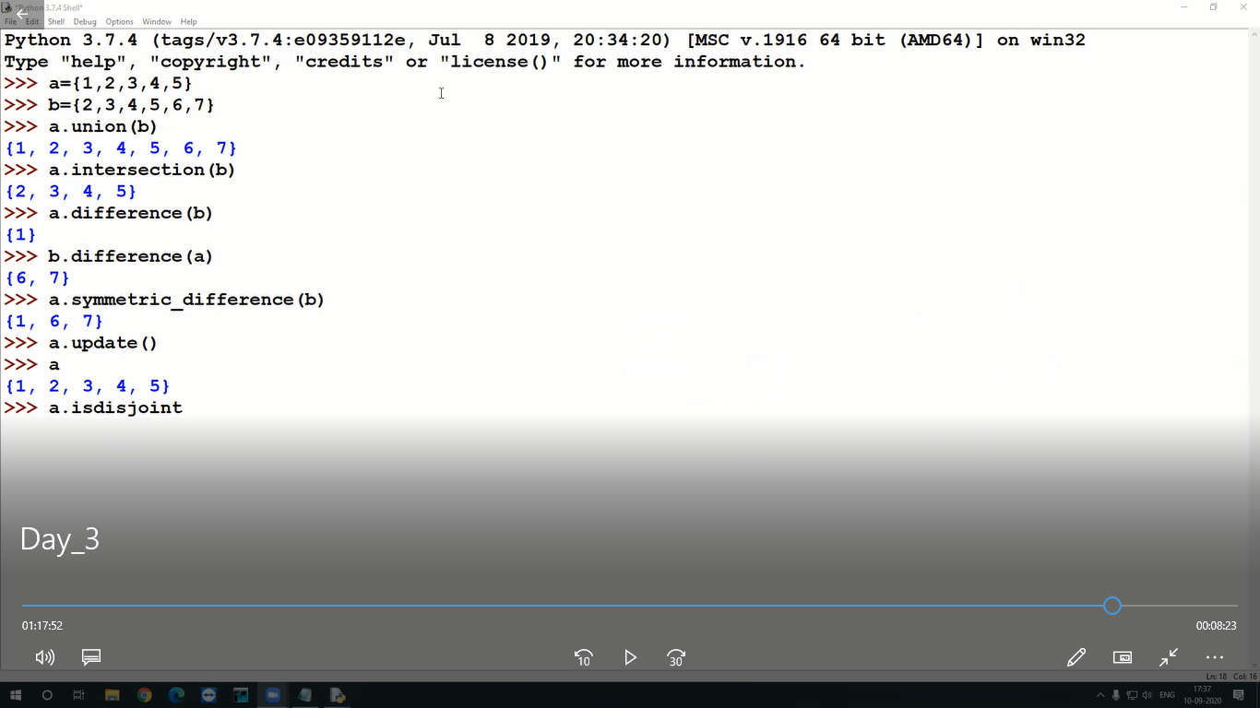
Built in function

Slide 4
A.add(“orange”)
A.Remove(“apple”) or a.Discard(“apple”)
a.pop()

Slide 5
Dictionary
Collection of elemets of paired data(keys and values)
A dictionary is a collection which is ordered*, changeable and does not allow duplicates.
Dictionary items are presented in key:value pairs, and can be referred to by using the key
car = {
"brand": "Ford",
"model": "Mustang",
"year": 1964
}
print(car["brand"])
car["brand"]="maruthi"
print(car)
key() – used to get keys of dictionary
print(car.keys()) name

Slide 6
Method | Description
clear() | Removes all the elements from the dictionary
copy() | Returns a copy of the dictionary
fromkeys() | Returns a dictionary with the specified keys and value
get() | Returns the value of the specified key
items() | Returns a list containing a tuple for each key value pair
keys() | Returns a list containing the dictionary's keys
pop() | Removes the element with the specified key
popitem() | Removes the last inserted key-value pair
setdefault() | Returns the value of the specified key. If the key does not exist: insert the key, with the specified value
update() | Updates the dictionary with the specified key-value pairs
values() | Returns a list of all the values in the dictionary

Slide 7
Adding Items
Adding an item to the dictionary is done by using a new index key and assigning a value to it
Eg : adding keys and item
car["owner"]="valar“
Removing
Pop() -method removes the item with the specified key name:
car.pop("year")
Popitem()-method removes the last inserted item

Slide 8
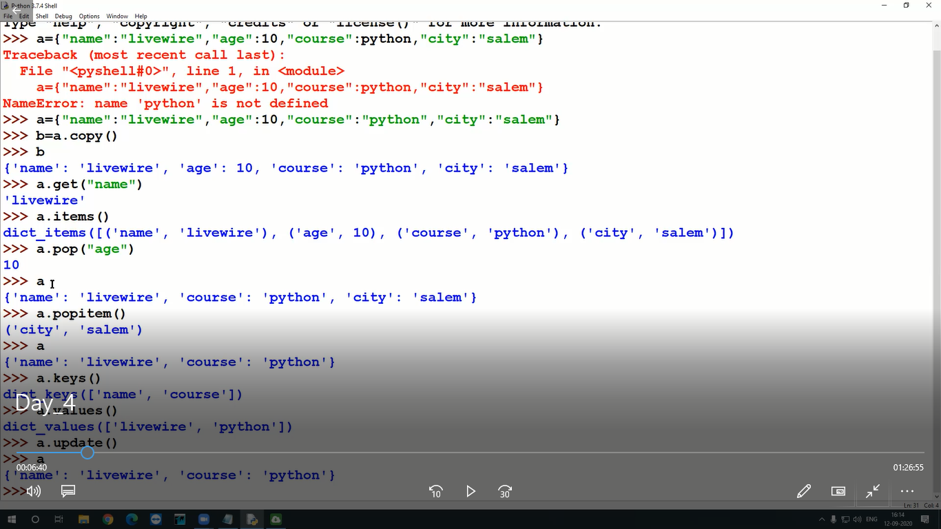

Slide 9
keys={"apple","banana","grapse"}
value="fruit"
f=dict.fromkeys(keys,value)
f
{'grapse': 'fruit', 'apple': 'fruit', 'banana': 'fruit'}

Slide 10
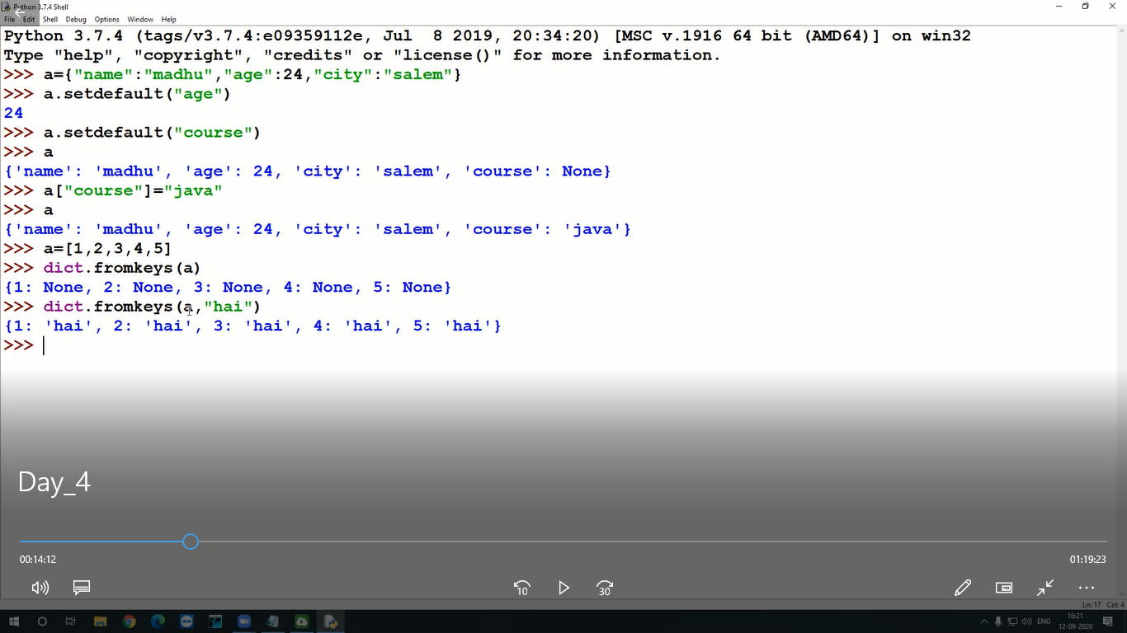

Slide 11
https://www.tutorialsteacher.com/python/error-types-in-python
1. Write a Python script to sort (ascending and descending) a dictionary by v
2.Write a Python script to check whether a given key already exists in a dictionary.alue

Slide 12
Write a Python script to check whether a given key already exists in a dictionary
Write a Python program to iterate over dictionaries using for loops.
Write a Python program to sort a dictionary by key
Write a Python program to get the maximum and minimum value in a dictionary.
Write a Python script to generate and print a dictionary that contains a number (between 1 and n) in the form (x, x*x). Sample Dictionary ( n = 5) : Expected Output : {1: 1, 2: 4, 3: 9, 4: 16, 5: 25}
Write a Python program to check if a set is a subset of another set.

Slide 13
Write a Python program to create and display all combinations of letters, selecting each letter from a different key in a dictionary. Go to the editor Sample data : {'1':['a','b'], '2':['c','d']} Expected Output: ac ad bc bd
Write a Python program to create a dictionary from a string. Go to the editor Note: Track the count of the letters from the string. Sample string : 'w3resource' Expected output: {'w': 1, '3': 1, 'r': 2, 'e': 2, 's': 1, 'o': 1, 'u': 1, 'c': 1}
Write a Python program to create a dictionary from a string. Go to the editor Note: Track the count of the letters from the string. Sample string : 'w3resource' Expected output: {'w': 1, '3': 1, 'r': 2, 'e': 2, 's': 1, 'o': 1, 'u': 1, 'c': 1}

Slide 14
Write a Python program to check if a given set is superset of itself and superset of another given set.
nums = {10,20,30,40,50}
print("Original set: ",nums)
print("If nums is superset of itself?")
print(nums.issuperset(nums))
num1 = {1, 2, 3, 4, 5, 7}
num2 = {2, 4}
num3 = {2, 4}
print("\nnum1 = ", num1)
print("num2 = ", num2)
print("num3 = ", num3)
print("If mum1 is superset of num2:")
print(num1>num2)
print("Compare mum2 and num3:")
print("If mum2 is superset of num3:")
print(num2>num3)
print("If mum3 is superset of num2:")
print(num3>num2)

Slide 15
Write a Python program to check if a set is a subset of another set
print("Check if a set is a subset of another set, using comparison operators and issubset():\n")
setx = set(["apple", "mango"])
sety = set(["mango", "orange"])
setz = set(["mango"])
print("x: ",setx)
print("y: ",sety)
print("z: ",setz,"\n")
print("If x is subset of y")
print(setx <= sety)
print(setx.issubset(sety))
print("If y is subset of x")
print(sety <= setx)
print(sety.issubset(setx))
print("\nIf y is subset of z")
print(sety <= setz)
print(sety.issubset(setz))
print("If z is subset of y")
print(setz <= sety)
print(setz.issubset(sety))

Slide 16
 | List | tuple | Set | Dictionary
datatype | Same or mixed | Same or mixed | Same or mixed | mixed
ordered | ordered | Ordered | Unordered | ordered
duplicate | Allow duplicate values | Allow duplicate values | Not allowed | duplicate key not allow, values can be duplicate
index | It is index based | It is also index based | It is not index based | Key based
Denote | [] | () | {} | {}
Mutable | It is mutable | It is not mutable | Mutable | mutable
Item assignment | Allow item assignment | Not allowed | Not allowed | It allows item assignment

Slide 17
s1={11,4,5,9,1}
s2={5,1,10,12}
sakthi
s1={3,2,10,14,19,18}
s2={2,19,16,17,18}

